Slide 1
Cryptoraunt: The crypto accepting restaurant finder.
By: Arthur Mouradian (ma9658) and Steffen Loh (ls3998)
Sponsored by IBM Cloud Power Systems Academic Initiative

Slide 2
Problem Statement:
In a society where finance is quickly moving towards the adoption of decentralized currencies like Bitcoin and Ethereum. It's difficult to know where and which restaurants accept your preferred cryptocurrency.
Our webapp will be a place where users can find which restaurants in a specific state/zip accepts cryptocurrency, so that they can plan accordingly.
Businesses (i.e. Restaurants) will also be able to sign up in order to gain access to a client base that they previously might not have had access to.

Slide 3
Functionality!
Users will be able to create a favorites list of their preferred cryptoraunt.
Restaurants will be able to create a profile/business account and display their location, menu items, cryptocurrencies accepted, and contact information.
Users will be able to search entire database of restaurants for those that accept a specific cryptocurrency (i.e. “Bitcoin”) – which then returns a list of restaurants that accept that currency.
Users will be able to search database for restaurants with specific cuisine – and can further narrow search by specifying state/zip/crypto
There will be a way to see which restaurants have been favorited the most by users – (this can be used to gauge how popular a restaurant is)

Slide 4
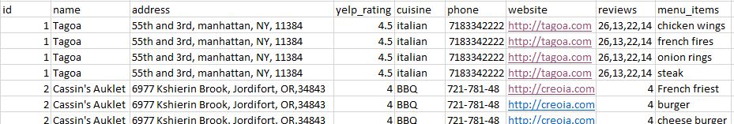
Attributes: (Pre Normalization)
Table: users
Id, name, age,address, favorites
Table: restaurants
Id, name, address, city, state, zip, yelp_rating, cuisine, phone, website, reviews, menu_items

Slide 5




Technologies used:

Slide 6
Normalization Process

Slide 7
1NF
Definition:
- Each cell should be in atomic form (i.e. contain a single value)
- Each record is unique
- No repeating groups
- Existence of Primary key
Lets start with the users table.

Slide 8
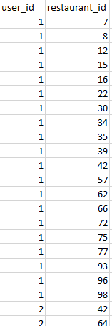


Problems:
- Our users table currently has fields that are not in atomic form.
- The following fields are the issues:
name, address, and favorites
The only solution to this is to make a table dedicated to keeping track of each favorite a user has – linking the favorite to each user by id.
Solutions:
- We can split name into first_name and last_name to make the field atomic.
- We can split address into street, city, state, zip to make it atomic
- We can split favorites into favorite 1, favorite 2, etc
BUT THIS CAUSES ANOTHER PROBLEM
Each entry in this table lists the user_id and the restaurant_id of the favorited restaurant.
This table is called: favorites
- Every user will have a first name and last name
- Every users address will be formatted the same
- But every user will NOT have the same amount of favorites.
This will result in a great many null fields, as we MUST create excess favorite columns to match the user that has the most favorites.

Slide 9

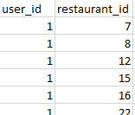
Table: users
Table: favorites
We've split our users table into two tables – users, and favorites and have made each field atomic.
Both tables also have a primary key.
These tables are now in at least 1NF.
Where are we at with 1NF now?
Now – time to normalize the restaurants table.

Slide 10
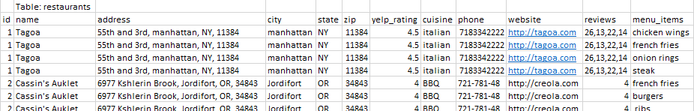
Problems:
- Like our users table, this table has fields that are not atomic.
- This table also has a LOT of repeated data.
Solutions:
- We can create the columns city, state, zip, and street from address. This gives us the same information and leaves each field in atomic form
- the reviews column can be completely removed. We make a table for reviews instead, and link each review to each restaurant by id.
- Similarly, to fix the repetition problem, we make menu_items its own table like reviews. This table will store the restaurant id, menu item, and that menu item's price.
One other feature we overlooked was how to incorporate which cryptocurrency each restaurant takes.
Following the solution to these normalization problems, we make another dedicated table called accepted_crypto, and have an entry made for each crypto a restaurant accepts.

Slide 11


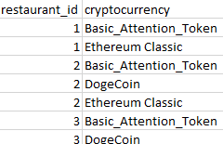
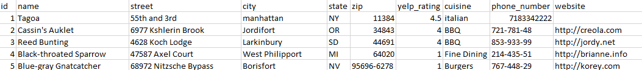
Table: reviews
Table: menu_items
Table: accepted_crypto
Table: restaurant

Slide 12
Where we're at in the normalization process.
All tables are now in 1NF because they satisfy the following requirements:
- Have a primary key
- Are in atomic form
- No repeating groups
Inadvertently, through normalizing the data the way we did by splitting things off into their own tables, these tables are in 3NF as well.
For 2NF, there must be no partial dependency, and there is not.
For 3NF, there must be no transitive dependency, and there appears to be no situation in which editing one table will result in issues with another table.

Slide 13
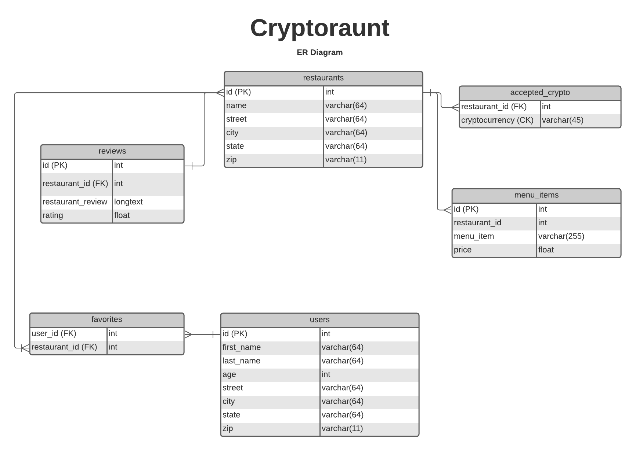

Slide 14
Data Generation and Insertion!

Slide 15
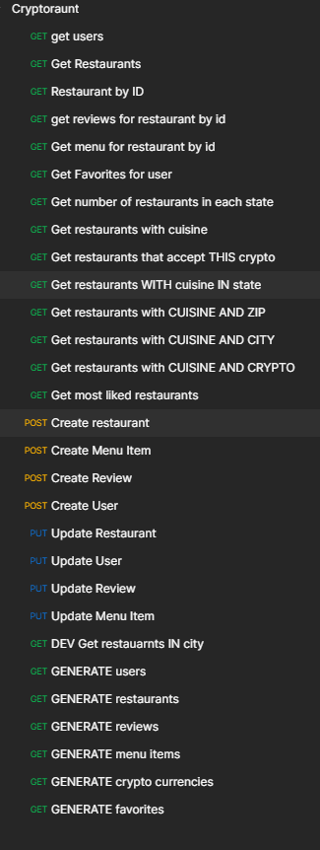
Data Generation!
We actually incorporated data generation into our projects API - It's how we got the data used in the demo we'll be showing you.
- One option is to use this to generate data for yourself, which will be completely unique.
- Another option is importing the data we've already generated and outputted to .csv files.

Slide 16
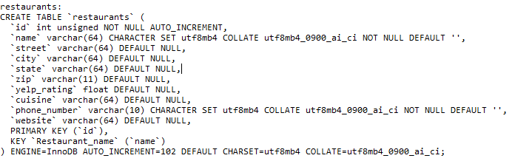
Data Insertion!
If you'd like to just import and use the same data we used, you can use the commands in our "Creation Scripts.txt" file to generate not only the tables, but also insert data stored in our exported .csv files
Example of commands in the text file (there're too many to share all of them in slides)

Slide 17
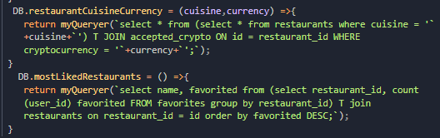
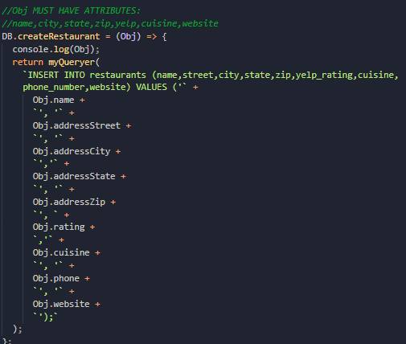
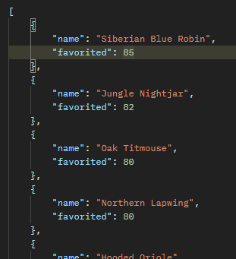
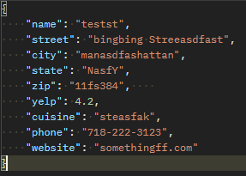
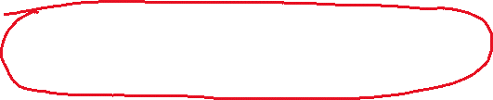

Some Example Queries used.
Example of one of our queries getting Data:
Example of our queries creating entries:

